Slide 1
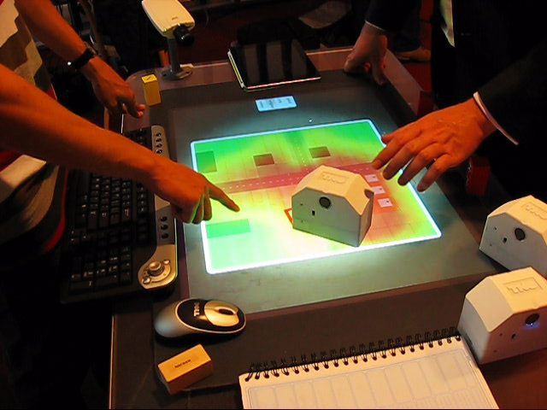
Towards Effective Affective Haptic Interaction
Alexander Toet, Jan B.F. van Erp, Joris B. Janssen

Slide 2

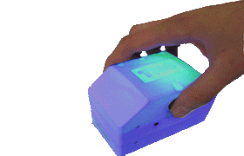
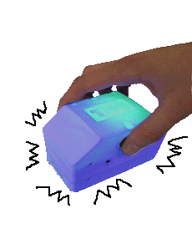
Sensators: active multisensory tangibles
Take haptic input
Touch
Pressure
Personalized multisensory feedback
Visual
Auditory
Tactile

Slide 3
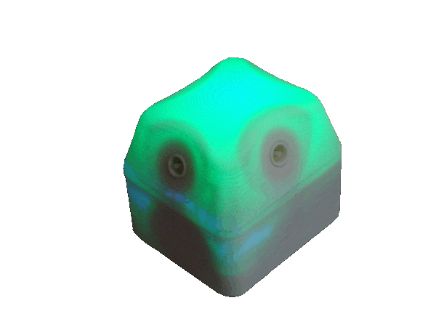

Slide 4
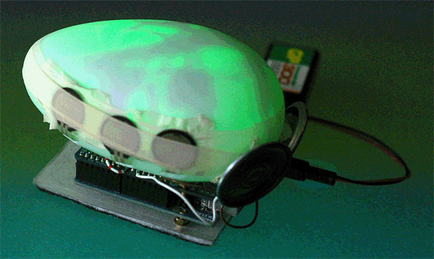

Slide 5
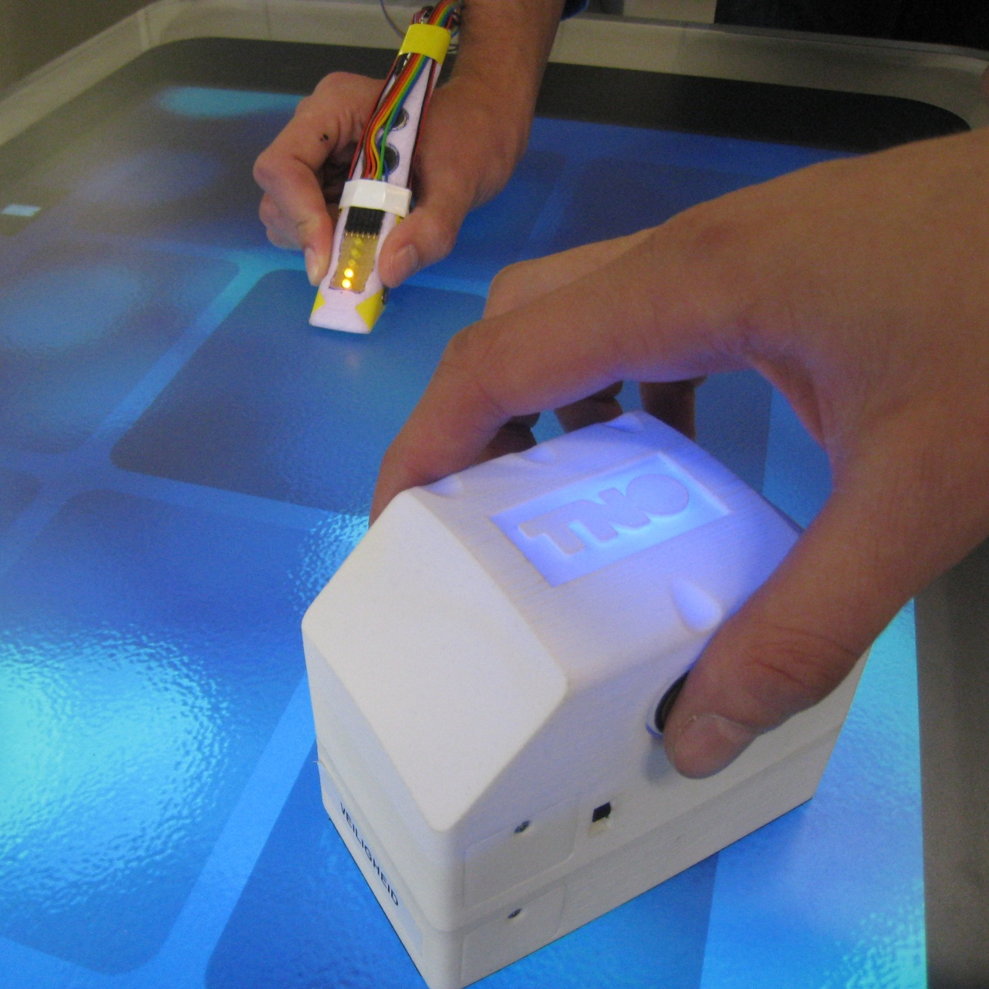

Slide 6
Multi-user multi-touch interfaces
Pro’s:
Intuitive
Facilitate multiple user interaction
Work with (passive) tangible objects
Con’s
Input only, no tactile feedback
No personalized info display

Slide 7
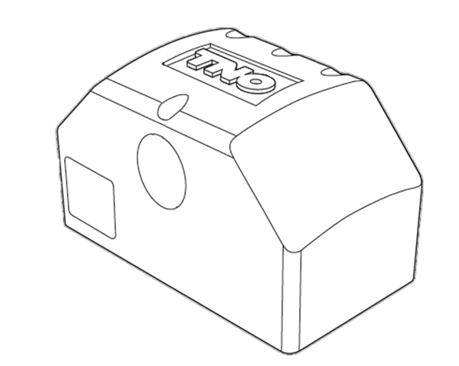
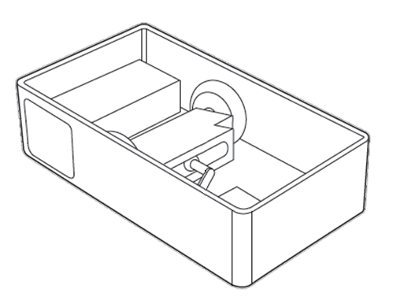
Dynamic shell color
- RGB LEDs
Finger landing points
- touch sensors
- vibrating elements
Audio
- speaker
- beeps
Wireless connection
- Bluetooth
Power supply
- battery

Slide 8
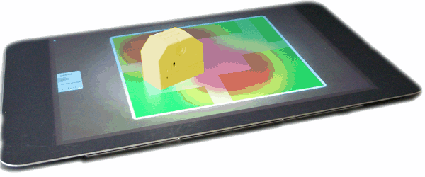

Slide 9
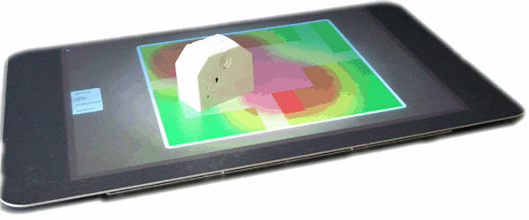

Slide 10
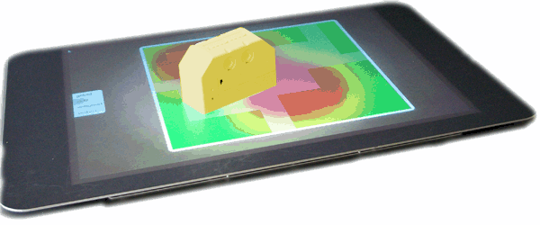

Slide 11
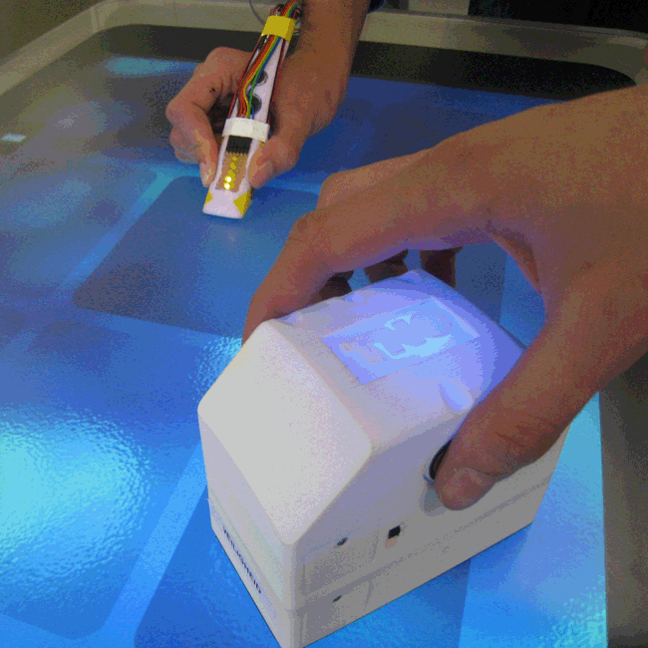

Slide 12
11
Affective Haptics
Vancouver, March 4 2012
Affect
Arousal
Pleasure

Slide 13
12
Affective Haptics
Vancouver, March 4 2012
Affect
Arousal
Stress
Excitement
Pleasure
Depression
Relaxation

Slide 14
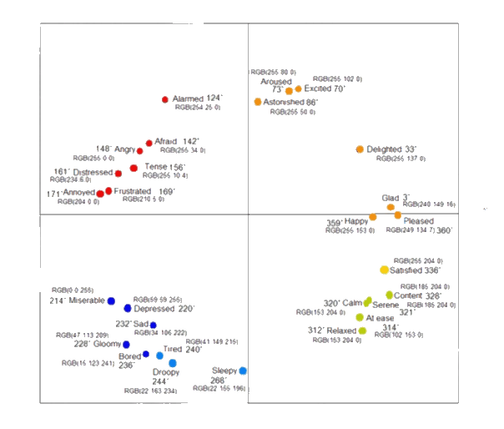
13
Affective Haptics
Vancouver, March 4 2012
Affect through Color
Arousal
Stress
Excitement
Red
Green
Pleasure
Blue
Sánchez et al., 2006;
Valdez & Mehrabian, 1994
Depression
Relaxation

Slide 15
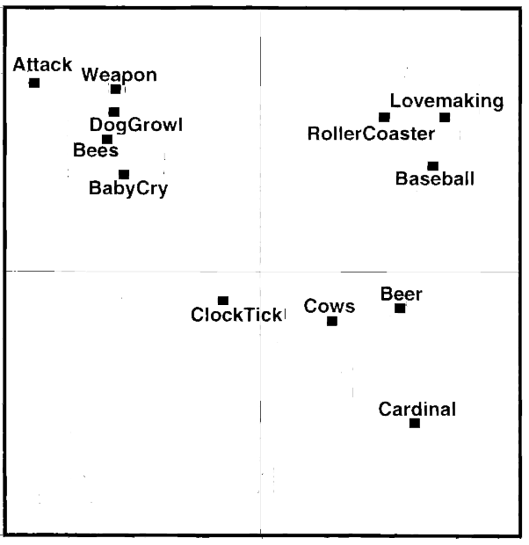
14
Affective Haptics
Vancouver, March 4 2012
Affect through Sound
Arousal
Stress
Excitement
Pleasure
Bradley & Lang, 2000
Depression
Relaxation

Slide 16
15
Affective Haptics
Vancouver, March 4 2012
Affect through Music
Arousal
Stress
Excitement
tempo
Minor Major
Pleasure
Tajadura-Jiménez et al., 2008)
Depression
Relaxation

Slide 17
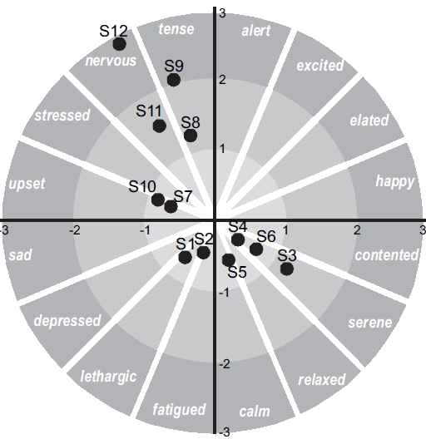
16
Affective Haptics
Vancouver, March 4 2012
Affect through Haptics
Arousal
Stress
Excitement
High frequency Low
Pleasure
Suk et al., 2009:
Depression
Relaxation

