Slide 1

Measuring and Improving the Quality of Haptic-Audio-Visual Experience
Haptics Symposium 2012 - Workshop on Affective Haptics

Slide 2
Content
Haptic feedback for audiovisual contents
Haptic-Audio-Visual System
Measuring the Quality of Experience
  Questionnaire
  Biosignals
Conclusion / Perspectives

Slide 3
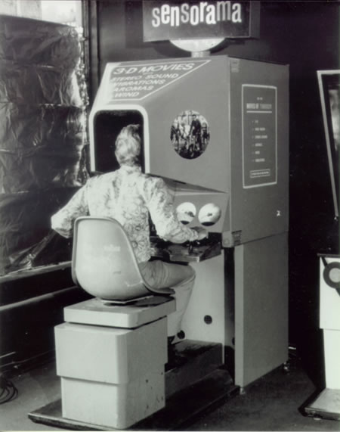
Haptic Feedback for AV Contents
Mainly used in virtual reality [Reiner2004]
  Presence
  Immersion
But also useful for multimedia
  Haptic effects enrich user experience [O’Modhrain2003]
  New medium to express content [Magnenat2006]
Heilig, 1962. Sensorama simulator.

Slide 4
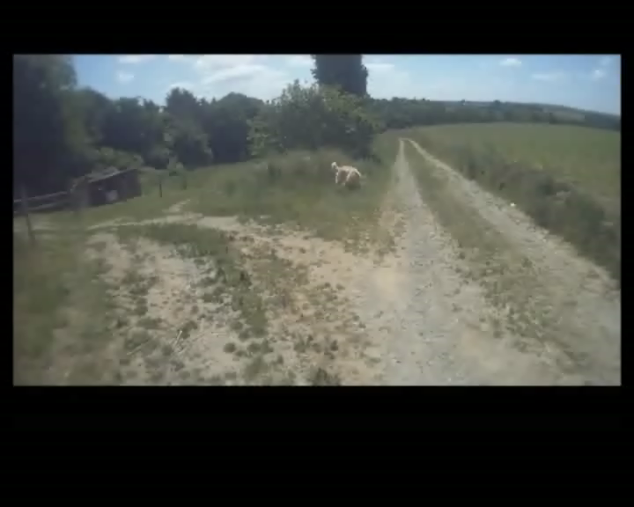
Haptic-Audiovisual System
Framework to add Haptic Effects to videos [Danieau2012]
  Capture
  Processing
  Rendering
Audiovisual content (on screen)
  First person view
Haptic content (on ff device)
  Motion effect
Cf. Poster + demo for details

Slide 5
Measuring the Quality of Experience
How to quantify the emotional impact of a Haptic-Audiovisual System?
  QoE = subjective user experience with a service or an application [Kilkki2008]
  QoE (Video + Haptic Feedback) > QoE (Video) ?
How to measure QoE?
Constraints
  Subjective experience
  Passive user
HAVs
AV
User
?
QoE
HF

Slide 6
Measuring the Quality of Experience Questionnaire : Design
Classical approach : questionnaire
User self-assessment
QoE evaluated by 4 factors
  Usability [ISO 9241-11]: how easy a system is to use
    Efficiency
    Effectiveness
    Satisfaction
  Presence [Witmer1998] : feeling to be physically situated in a virtual environment
    Realism
    Sensory
    Distraction
    Control
Comfort

Slide 7
Measuring the Quality of Experience
Questionnaire : Design
Allow to finely identify issues within the evaluated system
Each factor (question) rated on 5-point Likert scale
QoE Questionnaire → score
QoE
AV
HAVs
User
Realism
Quest.
Sensory
HF
Comfort
Satisfaction

Slide 8
Measuring the Quality of Experience Questionnaire : Example
Questionnaire design
  Questions to be adapted to experimental needs
    One factor may be more important than an other
    Nb of Q ≈ experiment duration
Example of a short questionnaire for pilot experiment
Factor | Question
Realism | How much did your experiences in the virtual environment seem consistent with your real-world experiences?
Sensory | How much did the haptic feedback improve the interaction?
Comfort | How much was the system comfortable?
Satisfaction | How much was the system pleasant to use?

Slide 9
Measuring the Quality of Experience Questionnaire : Results
Evaluation of our HAV System
Experiment
  15 subjects
  4 videos x 3 HF
QoE Questionnaire
Post-Exp Questionnaire
  Control questions
  Open-ended questions
QoE HF Real > QoE HF Random > QoE HF None

Slide 10
Measuring the Quality of Experience Questionnaire : Results
Deeper analysis

Slide 11
Measuring the Quality of Experience
QoE Questionnaire → subjective measure
How to collect objective data?
Measure of biosignals helps to identify emotion of subject
  Emotion part of QoE
  Biosignals → QoE ?

Slide 12
Measuring the Quality of Experience Biosignals: Affect Event Detector
Physiological-Based Affect Event Detector for Entertainment Video Applications [Fleureau2012]
Emotional Event and Binary Valence (Positive / Negative)
HAVs
AV
User
Biosig.
Emotional Event

Slide 13
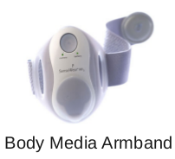
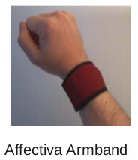
Measuring the Quality of Experience Biosignals: Affect Event Detector
Physiological signals
  ElectroDermal Answer (EDA)
  or Galvanic Skin Response (GSR)
  Heart Rate Variability (HRV)
  ElectroMyoGram (EMG)
  ElectroEncephaloGram (EEG)
  ElectroOculoGram (EOG)
  Respiration Rate
  Skin Temperature

Slide 14
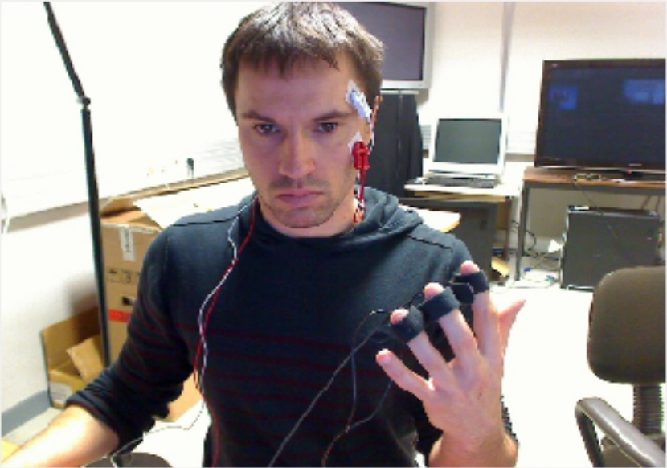
Measuring the Quality of Experience Biosignals: Affect Event Detector
Experimental Setup
Facial Muscles
Activity (EMG)
Heart Rate (PPG)
Skin Conductivity
(GSR)

Slide 15
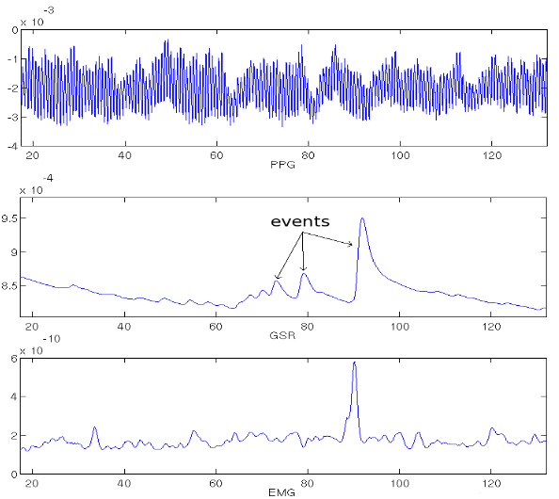
Measuring the Quality of Experience Biosignals: Affect Event Detector
Machine learning based detector [Fleureau2012]
  Gaussian process classifier
  Event detection
  Event classification
    Negative
    Positive
Example of captured signals

Slide 16

Measuring the Quality of Experience Biosignals: Example
Detection of emotional events [Fleureau2012]

Slide 17
Measuring the Quality of Experience Biosignals: Overview
Captured signals
  GSR / PPG → event detection
  EMG → valence identification
Detector
  Best accuracy if trained on user (need calibration)
  How to manage contradictory signals
Setup
  Ecological validity to be improved
  Influence of external conditions

Slide 18
Measuring the Quality of Experience Biosignals for QoE
Limitations
  Deeper validation required
  Tested with AV contents only
Interests for measuring the QoE
  Validation of questionnaire
  Allow to match haptic stimulus to user reaction

Slide 19
Measuring the Quality of Experience Questionnaire + Biosignals
Integration into QoE measure (ongoing)
New questions
  QoE Score: subjective vs objective
  Control points (Em. Valency = Satisfaction ?)
  Haptic Feedback → Positive Emotional Event : Joy or simple Surprise
QoE
AV
Realism
HAVs
User
Quest.
Sensory
Subjective
Comfort
Satisfaction
HF
Em. Events
Objective
biosig.
Em. Valency

Slide 20
Conclusion
Haptic feedback enhances video viewing experience = improve the QoE
QoE can be measured with Questionnaire
Emotional events can be detected thanks to biosignals
Ongoing: QoE Measure with Questionnaire + Biosignals

Slide 21
Thank you!
Fabien Danieau (fabien.danieau@technicolor.com),
Julien Fleureau,
Philippe Guillotel,
Nicolas Mollet,
Marc Christie,
Anatole Lécuyer.
F. Danieau, J. Fleureau, A. Cabec, P. Kerbiriou, P. Guillotel, N. Mollet, M. Christe, and A. Lécuyer, “A Framework for Enhancing Video Viewing Experience with Haptic Effects of Motion,” in IEEE Haptics Symposium (accepted), 2012.
J. Fleureau, P. Guillotel. “Physiological-Based Affect Event Detector for Entertainment Video Applications.”, in IEEE Transactions on Affective Computing, (accepted), 2012.

Slide 22
References
Reiner, M. (2004). The Role of Haptics in Immersive Telecommunication Environments. IEEE Transactions on Circuits and Systems for Video Technology, 14(3), 392-401.
O’Modhrain, S., & Oakley, I. (2003). Touch TV: Adding feeling to broadcast media. Proceedings of the 1st European Conference on Interactive Television: from Viewers to Actors.
Magnenat-Thalmann, N., & Bonanni, U. (2006). Haptics in virtual reality and multimedia. Multimedia, IEEE, 13(3), 6–11. IEEE.
K. Kilkki. Quality of experience in communications ecosystem. Journal of universal computer science, 14(5):615–624, 2008.
B. G. Witmer and M. J. Singer. Measuring presence in virtual environments : A presence questionnaire. Presence, pages 225–240, 1998.

